Slide 1



Real Estate Purchase (Smart) Contracts
Hamza, Lauren, Tarik, Suha
June 2021

Slide 2

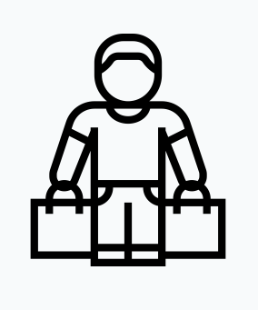




Motivation
Simple Breakdown of Real Estate Transaction
Property Title/Ownership
Buyer
Money
Seller
2.5% commission
2.5% commission
Real Estate Agent #1
Real Estate Agent #2
Key Takeaways
Average Toronto Selling Price: $1,025,000 -> commission of $51,250 to real estate agents
Value Add: Negotiation, Network, Ease of Documentation, Facilitation, Etc
Project Motivation: Is there a way we can give Buyer and Seller agent value, yet save them on 5% commission

Slide 3

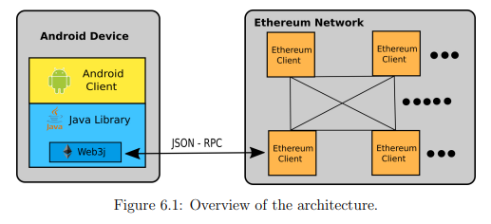
Inspiration: Schupfer , Florain, et al
Florain, Schupfer, et al – Design & Implementation of Smart Contract Application
Masters Thesis Paper
Android Web Application for Real Estate Smart Contracts:
Trade Contract
Purchase Agreement
Rental Contracts
Focus on Purchase Agreement Component; however, needed modification due to coding limitation (i.e. HTML vs Solidity)

Slide 4

Project Overview: Real Estate Purchase Smart Contract
Smart Contracts
Structure Smart Contract so that Buyer and Seller have trust and don’t betray each other/ abandon project
Smart Contract Structure
Step | Buyer/Seller | Step Name | Description
1 | Buyer | Blank Agreement | Buyer initiates blank agreement, stipulates purchase price, deposit, and other terms/agreement
2 | Buyer | Buyer Deposit | Buyer sends X% deposit to seller
3 | Seller | Seller Deposit | Seller sends X% deposit escrow account, incentive not to betray
4 | Buyer + Seller | Due Diligence | Identity verification, reps and warranties, etc
5 | Buyer | Confirms Received/Transfer | Buyer confirms reception of property rights and sends funds to Seller
6 | Seller | Refund Deposit | Seller Deposit returns after successful transaction
Buyer/Seller can abort operation

Slide 5
DEMO

Slide 6
Conclusion: Foundation vs Business
Initial Conclusions
Smart Contract functional to preform real estate purchase transaction between Buyer & Seller
Code inherently creates trust between Buyer & Seller, incentivizing not to betray process
Smart Contract ≠ Business
How do we replicate the intangible value of Real Estate Agents or TPPs?
How do we connect buyers and sellers?
How do we enforce smart contracts legally?
How do Buyers or Sellers convert fiat currency into cryptocurrency?
+1MM other questions
Project Limitations
Due Diligence documentation
Store, verify, and authenticate due diligence documentation
ID Documents for Buyer & Seller
Deeds/Title
Mortgage Pre-Approval, etc
Home ownership assumption
Assuming a 1:1 relationship between Buyers and Sellers
In some cases there might be more
Negotiation Flexibility
Assumes plain vanilla real estate transaction between Buyer and Seller
Real life real estate transactions are complex
Does not factor in for conditionals

